Slide 1
Course Code : | BPLCK105B/205B | Semester / Year : | II / I
Course Title : | Introduction to Python Programming | Academic Year : | 2024-25

Slide 2
Module 2
Lists: The List Data Type, Working with Lists, Augmented Assignment Operators, Methods, Example Program: Magic 8 Ball with a List, List-like Types: Strings and Tuples, References
Dictionaries and Structuring Data: The Dictionary Data Type, Pretty Printing, Using Data Structures to Model Real-World Things

Slide 3
Lists

Slide 4
Lists
Lists and tuples can contain multiple values, which makes writing programs that handle large amounts of data easier.
And since lists themselves can contain other lists, you can use them to arrange data into hierarchical structures.

Slide 5
Lists
THE LIST DATA TYPE
A list is a value that contains multiple values in an ordered sequence.
The term list value refers to the list itself (which is a value that can be stored in a variable or passed to a function like any other value), not the values inside the list value.
A list value looks like this: ['cat', 'bat', 'rat', 'elephant’].
Just as string values are typed with quote characters to mark where the string begins and ends, a list begins with an opening square bracket and ends with a closing square bracket, [].

Slide 6
Lists
THE LIST DATA TYPE
Values inside the list are also called items. Items are separated with commas (that is, they are comma-delimited).
For example, enter the following into the interactive shell:
>>> [1, 2, 3]
>>> ['cat', 'bat', 'rat', 'elephant']
>>> ['hello', 3.1415, True, None, 42]
➊ >>> spam = ['cat', 'bat', 'rat', 'elephant']
>>> spam
The spam variable ➊ is still assigned only one value: the list value.

Slide 7
Lists
THE LIST DATA TYPE
But the list value itself contains other values.
The value [] is an empty list that contains no values, similar to '', the empty string.

Slide 8
Lists
Getting Individual Values in a List with Indexes
Say you have the list ['cat', 'bat', 'rat', 'elephant'] stored in a variable named spam.
The Python code spam[0] would evaluate to 'cat', and spam[1] would evaluate to 'bat', and so on.
The integer inside the square brackets that follows the list is called an index.
The first value in the list is at index 0, the second value is at index 1, the third value is at index 2, and so on.

Slide 9
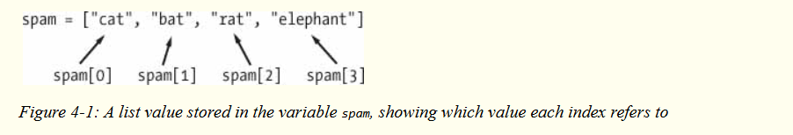
Lists
Getting Individual Values in a List with Indexes
Figure 4-1 shows a list value assigned to spam, along with what the index expressions would evaluate to.
Note that because the first index is 0, the last index is one less than the size of the list; a list of four items has 3 as its last index.

Slide 10
Lists
Getting Individual Values in a List with Indexes
For example, enter the following expressions into the interactive shell. Start by assigning a list to the variable spam.
>>> spam = ['cat', 'bat', 'rat', 'elephant']
>>> spam[0]
>>> spam[1]
>>> spam[2]
>>> spam[3]
>>> ['cat', 'bat', 'rat', 'elephant'][3]
➊ >>> 'Hello, ' + spam[0]
>>> 'The ' + spam[1] + ' ate the ' + spam[0] + '.'

Slide 11
Lists
Getting Individual Values in a List with Indexes
Notice that the expression 'Hello, ' + spam[0] ➊ evaluates to 'Hello, ' + 'cat' because spam[0] evaluates to the string 'cat'. This expression in turn evaluates to the string value 'Hello, cat' .
Python will give you an IndexError error message if you use an index that exceeds the number of values in your list value.
>>> spam = ['cat', 'bat', 'rat', 'elephant']
>>> spam[10000]
Indexes can be only integer values, not floats.

Slide 12
Lists
Getting Individual Values in a List with Indexes
The following example will cause a TypeError error:
>>> spam = ['cat', 'bat', 'rat', 'elephant']
>>> spam[1]
>>> spam[1.0]
>>> spam[int(1.0)]
Lists can also contain other list values.

Slide 13
Lists
Getting Individual Values in a List with Indexes
The values in these lists of lists can be accessed using multiple indexes, like so:
>>> spam = [['cat', 'bat'], [10, 20, 30, 40, 50]]
>>> spam[0]
>>> spam[0][1]
>>> spam[1][4]
The first index dictates which list value to use, and the second indicates the value within the list value. For example, spam[0][1] prints 'bat', the second value in the first list. If you only use one index, the program will print the full list value at that index.

Slide 14
Lists
Negative Indexes
While indexes start at 0 and go up, you can also use negative integers for the index.
The integer value -1 refers to the last index in a list, the value -2 refers to the second-to-last index in a list, and so on.
Enter the following into the interactive shell:
>>> spam = ['cat', 'bat', 'rat', 'elephant']
>>> spam[-1]
>>> spam[-3]
>>> 'The ' + spam[-1] + ' is afraid of the ' + spam[-3] + '.'

Slide 15
Lists
Getting a List from Another List with Slices
Just as an index can get a single value from a list, a slice can get several values from a list, in the form of a new list.
A slice is typed between square brackets, like an index, but it has two integers separated by a colon.
Notice the difference between indexes and slices.
spam[2] is a list with an index (one integer).
spam[1:4] is a list with a slice (two integers).
In a slice, the first integer is the index where the slice starts.
The second integer is the index where the slice ends.

Slide 16
Lists
Getting a List from Another List with Slices
A slice goes up to, but will not include, the value at the second index.
A slice evaluates to a new list value.
Enter the following into the interactive shell:
>>> spam = ['cat', 'bat', 'rat', 'elephant']
>>> spam[0:4]
>>> spam[1:3]
>>> spam[0:-1]

Slide 17
Lists
Getting a List from Another List with Slices
As a shortcut, you can leave out one or both of the indexes on either side of the colon in the slice. Leaving out the first index is the same as using 0, or the beginning of the list.
Leaving out the second index is the same as using the length of the list, which will slice to the end of the list.
Enter the following into the interactive shell:
>>> spam = ['cat', 'bat', 'rat', 'elephant']
>>> spam[:2]
>>> spam[1:]
>>> spam[:]

Slide 18
Lists
Getting a List’s Length with the len() Function
The len() function will return the number of values that are in a list value passed to it, just like it can count the number of characters in a string value.
Enter the following into the interactive shell:
>>> spam = ['cat', 'dog', 'moose']
>>> len(spam)

Slide 19
Lists
Changing Values in a List with Indexes
Normally, a variable name goes on the left side of an assignment statement, like spam = 42.
However, you can also use an index of a list to change the value at that index.
For example, spam[1] = 'aardvark' means “Assign the value at index 1 in the list spam to the string 'aardvark’.”

Slide 20
Lists
Changing Values in a List with Indexes
Enter the following into the interactive shell:
>>> spam = ['cat', 'bat', 'rat', 'elephant']
>>> spam[1] = 'aardvark'
>>> spam
>>> spam[2] = spam[1]
>>> spam
>>> spam[-1] = 12345
>>> spam

Slide 21
Lists
List Concatenation and List Replication
Lists can be concatenated and replicated just like strings.
The + operator combines two lists to create a new list value and the * operator can be used with a list and an integer value to replicate the list.
Enter the following into the interactive shell:
>>> [1, 2, 3] + ['A', 'B', 'C']
>>> ['X', 'Y', 'Z'] * 3
>>> spam = [1, 2, 3]
>>> spam = spam + ['A', 'B', 'C']
>>> spam

Slide 22
Lists
Removing Values from Lists with del Statements
The del statement will delete values at an index in a list.
All of the values in the list after the deleted value will be moved up one index.
For example, enter the following into the interactive shell:
>>> spam = ['cat', 'bat', 'rat', 'elephant']
>>> del spam[2]
>>> spam
>>> del spam[2]
>>> spam

Slide 23
Lists
Removing Values from Lists with del Statements
The del statement can also be used on a simple variable to delete it, as if it were an “unassignment” statement.
If you try to use the variable after deleting it, you will get a NameError error because the variable no longer exists.
In practice, you almost never need to delete simple variables. The del statement is mostly used to delete values from lists.

Slide 24
Lists
Removing Values from Lists with del Statements
The del statement can also be used on a simple variable to delete it, as if it were an “unassignment” statement.
If you try to use the variable after deleting it, you will get a NameError error because the variable no longer exists.
In practice, you almost never need to delete simple variables.
The del statement is mostly used to delete values from lists.

Slide 25
Lists
WORKING WITH LISTS
When you first begin writing programs, it’s tempting to create many individual variables to store a group of similar values.
For example, if I wanted to store the names of my cats, I might be tempted to write code like this:
catName1 = 'Zophie'
catName2 = 'Pooka'
catName3 = 'Simon'
catName4 = 'Lady Macbeth'
catName5 = 'Fat-tail'
catName6 = 'Miss Cleo'

Slide 26
Lists
WORKING WITH LISTS
It turns out that this is a bad way to write code. (Also, I don’t actually own this many cats, I swear.)
For one thing, if the number of cats changes, your program will never be able to store more cats than you have variables.
These types of programs also have a lot of duplicate or nearly identical code in them.
Consider how much duplicate code is in the following program, which you should enter into the file editor and save as allMyCats1.py:

Slide 27
Lists
WORKING WITH LISTS
print('Enter the name of cat 1:')
catName1 = input()
print('Enter the name of cat 2:')
catName2 = input()
print('Enter the name of cat 3:')
catName3 = input()
print('Enter the name of cat 4:')
catName4 = input()
print('Enter the name of cat 5:')
catName5 = input()

Slide 28
Lists
WORKING WITH LISTS
print('Enter the name of cat 6:')
catName6 = input()
print('The cat names are:')
print(catName1 + ' ' + catName2 + ' ' + catName3 + ' ' + catName4 + ' ' +
catName5 + ' ' + catName6)
Instead of using multiple, repetitive variables, you can use a single variable that contains a list value.
For example, here’s a new and improved version of the allMyCats1.py program.

Slide 29
Lists
WORKING WITH LISTS
This new version uses a single list and can store any number of cats that the user types in.
In a new file editor window, enter the following source code and save it as allMyCats2.py:
catNames = []
while True:
print('Enter the name of cat ' + str(len(catNames) + 1) +
' (Or enter nothing to stop.):')
name = input()

Slide 30
Lists
WORKING WITH LISTS
if name == '':
break
catNames = catNames + [name] # list concatenation
print('The cat names are:')
for name in catNames:
print(' ' + name)
The benefit of using a list is that your data is now in a structure, so your program is much more flexible in processing the data than it would be with several repetitive variables.

Slide 31
Lists
Using for Loops with Lists
Technically, a for loop repeats the code block once for each item in a list value. For example, if you ran this code:
for i in range(4):
print(i)
This is because the return value from range(4) is a sequence value that Python considers similar to [0, 1, 2, 3]. The following program has the same output as the previous one:
for i in [0, 1, 2, 3]:
print(i)

Slide 32
Lists
Using for Loops with Lists
The previous for loop actually loops through its clause with the variable i set to a successive value in the [0, 1, 2, 3] list in each iteration.
A common Python technique is to use range(len(someList)) with a for loop to iterate over the indexes of a list.

Slide 33
Lists
Using for Loops with Lists
For example, enter the following into the interactive shell:
>>> supplies = ['pens', 'staplers', 'flamethrowers', 'binders']
>>> for i in range(len(supplies)): print('Index ' + str(i) + ' in supplies is: ' + supplies[i])
Using range(len(supplies)) in the previously shown for loop is handy because the code in the loop can access the index (as the variable i) and the value at that index (as supplies[i]).
Best of all, range(len(supplies)) will iterate through all the indexes of supplies, no matter how many items it contains.

Slide 34
Lists
The in and not in Operators
You can determine whether a value is or isn’t in a list with the in and not in operators.
Like other operators, in and not in are used in expressions and connect two values: a value to look for in a list and the list where it may be found.
These expressions will evaluate to a Boolean value. Enter the following into the interactive shell:
>>> 'howdy' in ['hello', 'hi', 'howdy', 'heyas’]
>>> spam = ['hello', 'hi', 'howdy', 'heyas’]
>>> 'cat' in spam

Slide 35
Lists
The in and not in Operators
>>> 'howdy' not in spam
>>> 'cat' not in spam
For example, the following program lets the user type in a pet name and then checks to see whether the name is in a list of pets.

Slide 36
Lists
The in and not in Operators
Open a new file editor window, enter the following code, and save it as myPets.py:
myPets = ['Zophie', 'Pooka', 'Fat-tail']
print('Enter a pet name:')
name = input()
if name not in myPets:
print('I do not have a pet named ' + name)
else:
print(name + ' is my pet.')

Slide 37
Lists
The Multiple Assignment Trick
The multiple assignment trick (technically called tuple unpacking) is a shortcut that lets you assign multiple variables with the values in a list in one line of code. So instead of doing this:
>>> cat = ['fat', 'gray', 'loud']
>>> size = cat[0]
>>> color = cat[1]
>>> disposition = cat[2]
you could type this line of code:
>>> cat = ['fat', 'gray', 'loud']
>>> size, color, disposition = cat

Slide 38
Lists
The Multiple Assignment Trick
The number of variables and the length of the list must be exactly equal, or Python will give you a ValueError:
>>> cat = ['fat', 'gray', 'loud']
>>> size, color, disposition, name = cat

Slide 39
Lists
Using the enumerate() Function with Lists
We call the enumerate() function instead.
On each iteration of the loop, enumerate() will return two values: the index of the item in the list, and the item in the list itself. >>> supplies = ['pens', 'staplers', 'flamethrowers', 'binders']
>>> for index, item in enumerate(supplies):
... print('Index ' + str(index) + ' in supplies is: ' + item)
The enumerate() function is useful if you need both the item and the item’s index in the loop’s block.

Slide 40
Lists
Using the random.choice() and random.shuffle() Functions with Lists
The random module has a couple functions that accept lists for arguments.
The random.choice() function will return a randomly selected item from the list.
>>> import random
>>> pets = ['Dog', 'Cat', 'Moose’]
>>> random.choice(pets)
>>> random.choice(pets)
>>> random.choice(pets)

Slide 41
Lists
Using the random.choice() and random.shuffle() Functions with Lists
You can consider random.choice(someList) to be a shorter form of someList[random.randint(0, len(someList) – 1].
The random.shuffle() function will reorder the items in a list.
This function modifies the list in place, rather than returning a new list.
>>> import random
>>> people = ['Alice', 'Bob', 'Carol', 'David’]
>>> random.shuffle(people)
>>> people
>>> random.shuffle(people)
>>> people

Slide 42
Lists
AUGMENTED ASSIGNMENT OPERATORS
When assigning a value to a variable, you will frequently use the variable itself.
For example, after assigning 42 to the variable spam, you would increase the value in spam by 1 with the following code:
>>> spam = 42
>>> spam = spam + 1
>>> spam

Slide 43
Lists
AUGMENTED ASSIGNMENT OPERATORS
As a shortcut, you can use the augmented assignment operator += to do the same thing:
>>> spam = 42
>>> spam += 1
>>> spam

Slide 44
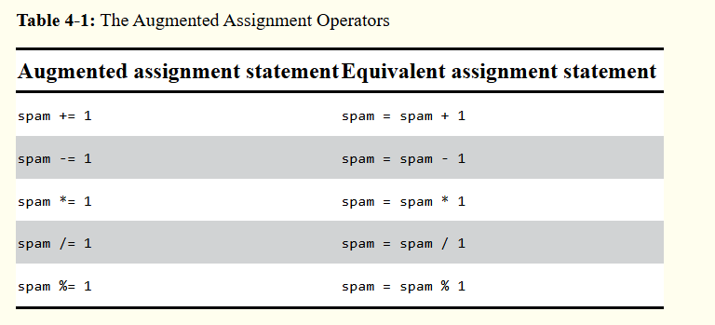
Lists
AUGMENTED ASSIGNMENT OPERATORS
There are augmented assignment operators for the +, -, *, /, and % operators, described in Table 4-1.

Slide 45
Lists
AUGMENTED ASSIGNMENT OPERATORS
The += operator can also do string and list concatenation, and the *= operator can do string and list replication.
>>> spam = 'Hello,'
>>> spam += ' world!'
>>> spam
>>> bacon = ['Zophie']
>>> bacon *= 3
>>> bacon

Slide 46
Lists
METHODS
A method is the same thing as a function, except it is “called on” a value.
For example, if a list value were stored in spam, you would call the index() list method (which I’ll explain shortly) on that list like so: spam.index('hello’).
The method part comes after the value, separated by a period.
Each data type has its own set of methods.
The list data type, for example, has several useful methods for finding, adding, removing, and otherwise manipulating values in a list.

Slide 47
Lists
Finding a Value in a List with the index() Method
List values have an index() method that can be passed a value, and if that value exists in the list, the index of the value is returned.
If the value isn’t in the list, then Python produces a ValueError error.
>>> spam = ['hello', 'hi', 'howdy', 'heyas’]
>>> spam.index('hello’)
>>> spam.index('heyas’)
>>> spam.index('howdy howdy howdy’)

Slide 48
Lists
Finding a Value in a List with the index() Method
When there are duplicates of the value in the list, the index of its first appearance is returned.
>>> spam = ['Zophie', 'Pooka', 'Fat-tail', 'Pooka’]
>>> spam.index('Pooka')

Slide 49
Lists
Adding Values to Lists with the append() and insert() Methods
To add new values to a list, use the append() and insert() methods.
>>> spam = ['cat', 'dog', 'bat']
>>> spam.append('moose')
>>> spam
The previous append() method call adds the argument to the end of the list.
The insert() method can insert a value at any index in the list.
The first argument to insert() is the index for the new value, and the second argument is the new value to be inserted.

Slide 50
Lists
Adding Values to Lists with the append() and insert() Methods
>>> spam = ['cat', 'dog', 'bat']
>>> spam.insert(1, 'chicken')
>>> spam
Notice that the code is spam.append('moose') and spam.insert(1, 'chicken'), not spam = spam.append('moose') and spam = spam.insert(1, 'chicken’).

Slide 51
Lists
Adding Values to Lists with the append() and insert() Methods
Neither append() nor insert() gives the new value of spam as its return value. (In fact, the return value of append() and insert() is None, so you definitely wouldn’t want to store this as the new variable value.) Rather, the list is modified in place.
Methods belong to a single data type.
The append() and insert() methods are list methods and can be called only on list values, not on other values such as strings or integers.

Slide 52
Lists
Adding Values to Lists with the append() and insert() Methods
>>> eggs = 'hello’
>>> eggs.append('world’)
>>> bacon = 42
>>> bacon.insert(1, 'world’)

Slide 53
Lists
Removing Values from Lists with the remove() Method
The remove() method is passed the value to be removed from the list it is called on. Enter the following into the interactive shell:
>>> spam = ['cat', 'bat', 'rat', 'elephant’]
>>> spam.remove('bat’)
>>> spam
Attempting to delete a value that does not exist in the list will result in a ValueError error.

Slide 54
Lists
Removing Values from Lists with the remove() Method
For example, enter the following into the interactive shell and notice the error that is displayed:
>>> spam = ['cat', 'bat', 'rat', 'elephant’]
>>> spam.remove('chicken')
If the value appears multiple times in the list, only the first instance of the value will be removed.
>>> spam = ['cat', 'bat', 'rat', 'cat', 'hat', 'cat’]
>>> spam.remove('cat’)
>>> spam

Slide 55
Lists
Removing Values from Lists with the remove() Method
The del statement is good to use when you know the index of the value you want to remove from the list.
The remove() method is useful when you know the value you want to remove from the list.

Slide 56
Lists
Sorting the Values in a List with the sort() Method
Lists of number values or lists of strings can be sorted with the sort() method.
>>> spam = [2, 5, 3.14, 1, -7]
>>> spam.sort()
>>> spam
>>> spam = ['ants', 'cats', 'dogs', 'badgers', 'elephants']
>>> spam.sort()
>>> spam

Slide 57
Lists
Sorting the Values in a List with the sort() Method
You can also pass True for the reverse keyword argument to have sort() sort the values in reverse order.
>>> spam.sort(reverse=True)
>>> spam
There are three things you should note about the sort() method.
First, the sort() method sorts the list in place; don’t try to capture the return value by writing code like spam = spam.sort().
Second, you cannot sort lists that have both number values and string values in them, since Python doesn’t know how to compare these values.

Slide 58
Lists
Sorting the Values in a List with the sort() Method
>>> spam = [1, 3, 2, 4, 'Alice', 'Bob’]
>>> spam.sort()
Third, sort() uses “ASCIIbetical order” rather than actual alphabetical order for sorting strings.
This means uppercase letters come before lowercase letters.
Therefore, the lowercase a is sorted so that it comes after the uppercase Z.

Slide 59
Lists
Sorting the Values in a List with the sort() Method
>>> spam = ['Alice', 'ants', 'Bob', 'badgers', 'Carol', 'cats']
>>> spam.sort()
>>> spam
If you need to sort the values in regular alphabetical order, pass str.lower for the key keyword argument in the sort() method call.
>>> spam = ['a', 'z', 'A', 'Z']
>>> spam.sort(key=str.lower)
>>> spam
This causes the sort() function to treat all the items in the list as if they were lowercase without actually changing the values in the list.

Slide 60
Lists
Sorting the Values in a List with the sort() Method
>>> spam = ['Alice', 'ants', 'Bob', 'badgers', 'Carol', 'cats']
>>> spam.sort()
>>> spam
If you need to sort the values in regular alphabetical order, pass str.lower for the key keyword argument in the sort() method call.

Slide 61
Lists
Sorting the Values in a List with the sort() Method
>>> spam = ['a', 'z', 'A', 'Z']
>>> spam.sort(key=str.lower)
>>> spam
This causes the sort() function to treat all the items in the list as if they were lowercase without actually changing the values in the list.

Slide 62
Lists
Reversing the Values in a List with the reverse() Method
If you need to quickly reverse the order of the items in a list, you can call the reverse() list method.
>>> spam = ['cat', 'dog', 'moose']
>>> spam.reverse()
>>> spam

Slide 63
Lists
EXCEPTIONS TO INDENTATION RULES IN PYTHON
In most cases, the amount of indentation for a line of code tells Python what block it is in. There are some exceptions to this rule, however. For example, lists can actually span several lines in the source code file. The indentation of these lines does not matter; Python knows that the list is not finished until it sees the ending square bracket. For example, you can have code that looks like this:
spam = ['apples’,’oranges','bananas','cats']
print(spam)
Of course, practically speaking, most people use Python’s behavior to make their lists look pretty and readable, like the messages list in the Magic 8 Ball program.

Slide 64
Lists
EXCEPTIONS TO INDENTATION RULES IN PYTHON
You can also split up a single instruction across multiple lines using the \ line continuation character at the end. Think of \ as saying, “This instruction continues on the next line.” The indentation on the line after a \ line continuation is not significant. For example, the following is valid Python code:
print('Four score and seven ' + \
'years ago...')
These tricks are useful when you want to rearrange long lines of Python code to be a bit more readable.

Slide 65
Lists
Reversing the Values in a List with the reverse() Method
Like the sort() list method, reverse() doesn’t return a list. This is why you write spam.reverse(), instead of spam = spam.reverse().

Slide 66
Lists
EXAMPLE PROGRAM: MAGIC 8 BALL WITH A LIST
Using lists, you can write a much more elegant version of the previous chapter’s Magic 8 Ball program.
Instead of several lines of nearly identical elif statements, you can create a single list that the code works with.
import random
messages = ['It is certain','It is decidedly so','Yes definitely','Reply hazy try again','Ask again later','Concentrate and ask again','My reply is no','Outlook not so good','Very doubtful’]

Slide 67
Lists
EXAMPLE PROGRAM: MAGIC 8 BALL WITH A LIST
print(messages[random.randint(0, len(messages) - 1)])
Notice the expression you use as the index for messages: random.randint (0, len(messages) - 1). This produces a random number to use for the index, regardless of the size of messages. That is, you’ll get a random number between 0 and the value of len(messages) - 1. The benefit of this approach is that you can easily add and remove strings to the messages list without changing other lines of code. If you later update your code, there will be fewer lines you have to change and fewer chances for you to introduce bugs.

Slide 68
Lists
SEQUENCE DATA TYPES
Lists aren’t the only data types that represent ordered sequences of values.
For example, strings and lists are actually similar if you consider a string to be a “list” of single text characters.
The Python sequence data types include lists, strings, range objects returned by range(), and tuples.
Many of the things you can do with lists can also be done with strings and other values of sequence types: indexing; slicing; and using them with for loops, with len(), and with the in and not in operators.

Slide 69
Lists
SEQUENCE DATA TYPES
>>> name = 'Zophie'
>>> name[0]
>>> name[-2]
>>> name[0:4]
>>> 'Zo' in name
>>> 'z' in name
>>> 'p' not in name
>>> for i in name:
... print('* * * ' + i + ' * * *')

Slide 70
Lists
Mutable and Immutable Data Types
But lists and strings are different in an important way.
A list value is a mutable data type: it can have values added, removed, or changed. However, a string is immutable: it cannot be changed.
>>> name = 'Zophie a cat'
>>> name[7] = 'the’

Slide 71
Lists
Mutable and Immutable Data Types
The proper way to “mutate” a string is to use slicing and concatenation to build a new string by copying from parts of the old string.
>>> name = 'Zophie a cat'
>>> newName = name[0:7] + 'the' + name[8:12]
>>> name
>>> newname
We used [0:7] and [8:12] to refer to the characters that we don’t wish to replace. Notice that the original 'Zophie a cat' string is not modified, because strings are immutable.

Slide 72
Lists
Mutable and Immutable Data Types
Although a list value is mutable, the second line in the following code does not modify the list eggs:
>>> eggs = [1, 2, 3]
>>> eggs = [4, 5, 6]
>>> eggs
The list value in eggs isn’t being changed here; rather, an entirely new and different list value ([4, 5, 6]) is overwriting the old list value ([1, 2, 3]). This is depicted in Figure 4-2.

Slide 73
Lists
Mutable and Immutable Data Types
If you wanted to actually modify the original list in eggs to contain [4, 5, 6], you would have to do something like this:
>>> eggs = [1, 2, 3]
>>> del eggs[2]
>>> del eggs[1]
>>> del eggs[0]
>>> eggs.append(4)
>>> eggs.append(5)
>>> eggs.append(6)
>>> eggs

Slide 74
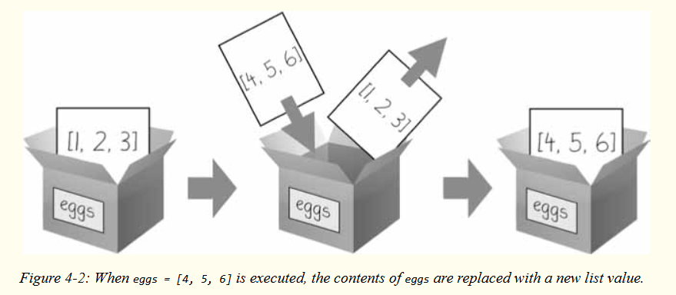
Lists
Mutable and Immutable Data Types

Slide 75
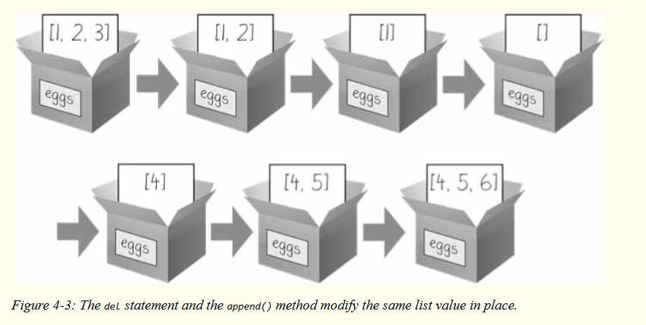
Lists
Mutable and Immutable Data Types
In the first example, the list value that eggs ends up with is the same list value it started with. It’s just that this list has been changed, rather than overwritten.
Figure 4-3 depicts the seven changes made by the first seven lines in the previous interactive shell example.

Slide 76
Lists
Mutable and Immutable Data Types
Changing a value of a mutable data type (like what the del statement and append() method do in the previous example) changes the value in place, since the variable’s value is not replaced with a new list value.

Slide 77
Lists
The Tuple Data Type
The tuple data type is almost identical to the list data type, except in two ways.
First, tuples are typed with parentheses, ( and ), instead of square brackets, [ and ].
>>> eggs = ('hello', 42, 0.5)
>>> eggs[0]
>>> eggs[1:3]
>>> len(eggs)
But the main way that tuples are different from lists is that tuples, like strings, are immutable.

Slide 78
Lists
The Tuple Data Type
Tuples cannot have their values modified, appended, or removed. >>> eggs = ('hello', 42, 0.5)
>>> eggs[1] = 99
If you have only one value in your tuple, you can indicate this by placing a trailing comma after the value inside the parentheses.
Otherwise, Python will think you’ve just typed a value inside regular parentheses.
The comma is what lets Python know this is a tuple value. (Unlike some other programming languages, it’s fine to have a trailing comma after the last item in a list or tuple in Python.)

Slide 79
Lists
The Tuple Data Type
>>> type(('hello',))
>>> type(('hello'))
You can use tuples to convey to anyone reading your code that you don’t intend for that sequence of values to change.
If you need an ordered sequence of values that never changes, use a tuple.
A second benefit of using tuples instead of lists is that, because they are immutable and their contents don’t change, Python can implement some optimizations that make code using tuples slightly faster than code using lists.

Slide 80
Lists
Converting Types with the list() and tuple() Functions
Just like how str(42) will return '42', the string representation of the integer 42, the functions list() and tuple() will return list and tuple versions of the values passed to them.
>>> tuple(['cat', 'dog', 5])
>>> list(('cat', 'dog', 5))
>>> list('hello')
Converting a tuple to a list is handy if you need a mutable version of a tuple value.

Slide 81
Lists
Converting Types with the list() and tuple() Functions
Just like how str(42) will return '42', the string representation of the integer 42, the functions list() and tuple() will return list and tuple versions of the values passed to them.
>>> tuple(['cat', 'dog', 5])
>>> list(('cat', 'dog', 5))
>>> list('hello')
Converting a tuple to a list is handy if you need a mutable version of a tuple value.

Slide 82
Lists
References
Variables “store” strings and integer values. This explanation is a simplification of what Python is actually doing. Technically, variables are storing references to the computer memory locations where the values are stored.
>>> spam = 42
>>> cheese = spam
>>> spam = 100
>>> spam
>>> cheese

Slide 83
Lists
References
When you assign 42 to the spam variable, you are actually creating the 42 value in the computer’s memory and storing a reference to it in the spam variable.
When you copy the value in spam and assign it to the variable cheese, you are actually copying the reference.
Both the spam and cheese variables refer to the 42 value in the computer’s memory.
When you later change the value in spam to 100, you’re creating a new 100 value and storing a reference to it in spam.

Slide 84
Lists
References
This doesn’t affect the value in cheese. Integers are immutable values that don’t change; changing the spam variable is actually making it refer to a completely different value in memory.
But lists don’t work this way, because list values can change; that is, lists are mutable.

Slide 85
Lists
References
Here is some code that will make this distinction easier to understand.
➊ >>> spam = [0, 1, 2, 3, 4, 5]
➋ >>> cheese = spam # The reference is being copied, not the list.
➌ >>> cheese[1] = 'Hello!' # This changes the list value.
>>> spam
>>> cheese # The cheese variable refers to the same list.
This might look odd to you. The code touched only the cheese list, but it seems that both the cheese and spam lists have changed.

Slide 86
Lists
References
When you create the list ➊, you assign a reference to it in the spam variable.
But the next line ➋ copies only the list reference in spam to cheese, not the list value itself.
This means the values stored in spam and cheese now both refer to the same list.
There is only one underlying list because the list itself was never actually copied.
So when you modify the first element of cheese ➌, you are modifying the same list that spam refers to.

Slide 87
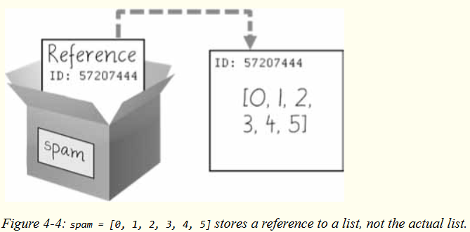
Lists
References
Remember that variables are like boxes that contain values.
The previous figures in this chapter show that lists in boxes aren’t exactly accurate, because list variables don’t actually contain lists—they contain references to lists.
Using boxes as a metaphor for variables, Figure 4-4 shows what happens when a list is assigned to the spam variable.

Slide 88
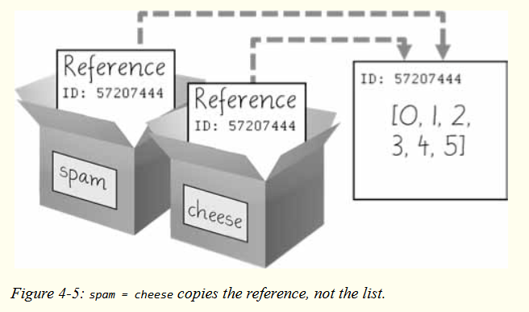
Lists
References
Then, in Figure 4-5, the reference in spam is copied to cheese. Only a new reference was created and stored in cheese, not a new list. Note how both references refer to the same list.

Slide 89
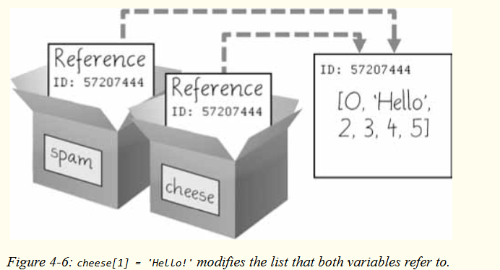
Lists
References
When you alter the list that cheese refers to, the list that spam refers to is also changed, because both cheese and spam refer to the same list. You can see this in Figure 4-6.

Slide 90
Lists
Identity and the id() Function
You may be wondering why the weird behavior with mutable lists in the previous section doesn’t happen with immutable values like integers or strings.
We can use Python’s id() function to understand this.
All values in Python have a unique identity that can be obtained with the id() function.
>>> id('Howdy') # The returned number will be different on your machine.
44491136

Slide 91
Lists
Identity and the id() Function
When Python runs id('Howdy'), it creates the 'Howdy' string in the computer’s memory.
The numeric memory address where the string is stored is returned by the id() function.
Python picks this address based on which memory bytes happen to be free on your computer at the time, so it’ll be different each time you run this code.
Like all strings, 'Howdy' is immutable and cannot be changed.

Slide 92
Lists
Identity and the id() Function
If you “change” the string in a variable, a new string object is being made at a different place in memory, and the variable refers to this new string.
For example, enter the following into the interactive shell and see how the identity of the string referred to by bacon changes:
>>> bacon = 'Hello’
>>> id(bacon)
>>> bacon += ' world!' # A new string is made from 'Hello' and ' world!’.

Slide 93
Lists
Identity and the id() Function
>>> id(bacon) # bacon now refers to a completely different string.
However, lists can be modified because they are mutable objects.
The append() method doesn’t create a new list object; it changes the existing list object. We call this “modifying the object in-place.”
>>> eggs = ['cat', 'dog'] # This creates a new list.
>>> id(eggs)
>>> eggs.append('moose') # append() modifies the list "in place".

Slide 94
Lists
Identity and the id() Function
>>> id(eggs) # eggs still refers to the same list as before.
>>> eggs = ['bat', 'rat', 'cow'] # This creates a new list, which has a new
identity.
>>> id(eggs) # eggs now refers to a completely different list.

Slide 95
Lists
Identity and the id() Function
If two variables refer to the same list (like spam and cheese in the previous section) and the list value itself changes, both variables are affected because they both refer to the same list. The append(), extend(), remove(), sort(), reverse(), and other list methods modify their lists in place.
Python’s automatic garbage collector deletes any values not being referred to by any variables to free up memory.
You don’t need to worry about how the garbage collector works, which is a good thing: manual memory management in other programming languages is a common source of bugs.

Slide 96
Lists
Passing References
References are particularly important for understanding how arguments get passed to functions.
When a function is called, the values of the arguments are copied to the parameter variables.
For lists (and dictionaries, which I’ll describe in the next chapter), this means a copy of the reference is used for the parameter.
def eggs(someParameter):
someParameter.append('Hello’)
spam = [1, 2, 3]

Slide 97
Lists
Passing References
eggs(spam)
print(spam)
Notice that when eggs() is called, a return value is not used to assign a new value to spam.
Instead, it modifies the list in place, directly. When run, this program produces the following output:
[1, 2, 3, 'Hello']
Even though spam and someParameter contain separate references, they both refer to the same list.

Slide 98
Lists
Passing References
This is why the append('Hello') method call inside the function affects the list even after the function call has returned.
Keep this behavior in mind: forgetting that Python handles list and dictionary variables this way can lead to confusing bugs.

Slide 99
Lists
The copy Module’s copy() and deepcopy() Functions
Although passing around references is often the handiest way to deal with lists and dictionaries, if the function modifies the list or dictionary that is passed, you may not want these changes in the original list or dictionary value.
For this, Python provides a module named copy that provides both the copy() and deepcopy() functions.
The first of these, copy.copy(), can be used to make a duplicate copy of a mutable value like a list or dictionary, not just a copy of a reference.

Slide 100
Lists
The copy Module’s copy() and deepcopy() Functions
>>> import copy
>>> spam = ['A', 'B', 'C', 'D’]
>>> id(spam)
>>> cheese = copy.copy(spam)
>>> id(cheese) # cheese is a different list with different identity.
>>> cheese[1] = 42
>>> spam
>>> cheese

Slide 101
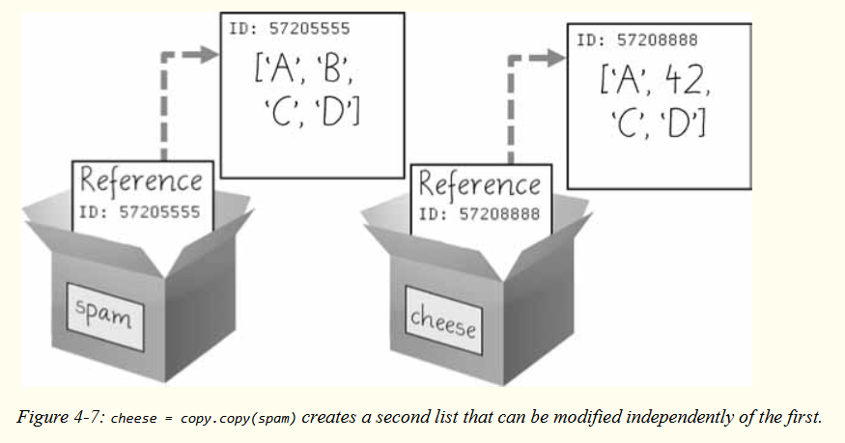
Lists
The copy Module’s copy() and deepcopy() Functions
Now the spam and cheese variables refer to separate lists, which is why only the list in cheese is modified when you assign 42 at index 1. As you can see in Figure 4-7, the reference ID numbers are no longer the same for both variables because the variables refer to independent lists.

Slide 102
Lists
The copy Module’s copy() and deepcopy() Functions
If the list you need to copy contains lists, then use
the copy.deepcopy() function instead of copy.copy().
The deepcopy() function will copy these inner lists as well.

Slide 103
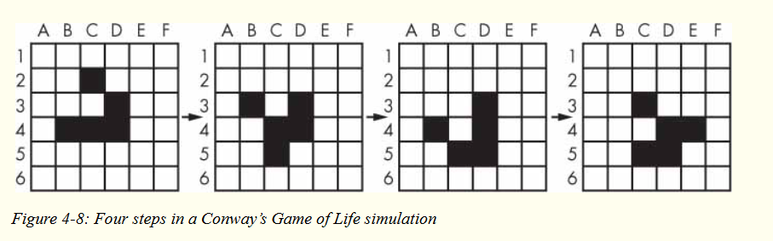
A Short Program: Conway’s Game of Life

Slide 104
Practice Questions
1. What is []?
2. How would you assign the value 'hello' as the third value in a list stored in a variable named spam? (Assume spam contains [2, 4, 6, 8, 10].)
For the following three questions, let’s say spam contains the list ['a', 'b', 'c', 'd'].
3. What does spam[int(int('3' * 2) // 11)] evaluate to?
4. What does spam[-1] evaluate to?
5. What does spam[:2] evaluate to?
For the following three questions, let’s say bacon contains the list [3.14, 'cat', 11, 'cat', True].

Slide 105
Practice Questions
6. What does bacon.index('cat') evaluate to?
7. What does bacon.append(99) make the list value in bacon look like?
8. What does bacon.remove('cat') make the list value in bacon look like?
9. What are the operators for list concatenation and list replication?
10. What is the difference between the append() and insert() list methods?
11. What are two ways to remove values from a list?
12. Name a few ways that list values are similar to string values.
13. What is the difference between lists and tuples?

Slide 106
Practice Questions
14. How do you type the tuple value that has just the integer value 42 in it?
15. How can you get the tuple form of a list value? How can you get the list form of a tuple value?
16. Variables that “contain” list values don’t actually contain lists directly. What do they contain instead?
17. What is the difference between copy.copy() and copy.deepcopy()?

Slide 107
Practice Projects
Comma Code
Say you have a list value like this:
spam = ['apples', 'bananas', 'tofu', 'cats']
Write a function that takes a list value as an argument and returns a string with all the items separated by a comma and a space, with and inserted before the last item. For example, passing the previous spam list to the function would return 'apples, bananas, tofu, and cats'. But your function should be able to work with any list value passed to it. Be sure to test the case where an empty list [] is passed to your function.

Slide 108
Practice Projects
Coin Flip Streaks
For this exercise, we’ll try doing an experiment. If you flip a coin 100 times and write down an “H” for each heads and “T” for each tails, you’ll create a list that looks like “T T T T H H H H T T.” If you ask a human to make up 100 random coin flips, you’ll probably end up with alternating head-tail results like “H T H T H H T H T T,” which looks random (to humans), but isn’t mathematically random. A human will almost never write down a streak of six heads or six tails in a row, even though it is highly likely to happen in truly random coin flips. Humans are predictably bad at being random.

Slide 109
Practice Projects
Coin Flip Streaks
Write a program to find out how often a streak of six heads or a streak of six tails comes up in a randomly generated list of heads and tails. Your program breaks up the experiment into two parts: the first part generates a list of randomly selected 'heads' and 'tails' values, and the second part checks if there is a streak in it. Put all of this code in a loop that repeats the experiment 10,000 times so we can find out what percentage of the coin flips contains a streak of six heads or tails in a row. As a hint, the function call random.randint(0, 1) will return a 0 value 50% of the time and a 1 value the other 50% of the time.

Slide 110
Practice Projects
Character Picture Grid
Say you have a list of lists where each value in the inner lists is a one-character string, like this:
grid = [['.', '.', '.', '.', '.', '.'],
['.', 'O', 'O', '.', '.', '.'],
['O', 'O', 'O', 'O', '.', '.'],
['O', 'O', 'O', 'O', 'O', '.'],
['.', 'O', 'O', 'O', 'O', 'O'],
['O', 'O', 'O', 'O', 'O', '.'],
['O', 'O', 'O', 'O', '.', '.'],
['.', 'O', 'O', '.', '.', '.'],
['.', '.', '.', '.', '.', '.']]

Slide 111
Practice Projects
Character Picture Grid
Think of grid[x][y] as being the character at the x- and y-coordinates of a “picture” drawn with text characters. The (0, 0) origin is in the upper-left corner, the x-coordinates increase going right, and the y-coordinates increase going down.

Slide 112
Practice Projects
Character Picture Grid
Copy the previous grid value, and write code that uses it to print the image.
..OO.OO..
.OOOOOOO.
.OOOOOOO.
..OOOOO..
...OOO...
....O....

